Slide 1


NETFLIX
EXPLORATORY DATA ANALYSIS REPORT
This presentation provides an in-depth look into my Netflix Exploratory Data Analysis project using MySQL. Here’s the analysis and insights derived from Netflix’s content data.
Presented by: Sajid Shaikh Position: Data Analyst Intern Organization: Unified Mentor

Slide 2
Table of Content
Project Overview
Methodology
Problem Statements
Insights
Recommendations

Slide 3
PROJECT OVERVIEW
To analyze Netflix’s content library and uncover trends in content type, country production, release years, genres, and ratings.
Provide insights that can help Netflix optimize its content strategy.
Data Source: Netflix dataset with columns including - Type, Title, Director, Country, Date_Added, Release_Year, Rating, Duration, Genre.

Slide 4
Data Cleaning:
Removal of missing values (e.g., directors, countries, and ratings).
Standardizing date formats and extracting relevant time-based insights.
Analysis Techniques:
Aggregations, rankings, and distribution analysis.
SQL for data exploration and query-driven insights.
Tools Used:
SQL for data querying and analysis.
METHODOLOGY

Slide 5
PROBLEM STATEMENTS
Content Type Distribution: What is the distribution of content types (Movies vs. TV Shows) on Netflix?
Top Countries by Content Production: Which countries produce the most content (both Movies and TV Shows) on Netflix?
Content Added Over Time: How has the number of movies and TV shows added to Netflix changed over the years?
Top Directors: Who are the top 5 most frequent directors on Netflix?
Yearly Releases: What is the trend in the number of movies and TV shows released over the years?
Genre Popularity: What are the most common genres listed for Netflix content?
Content per Country: Which countries have produced the most movies and TV shows in each genre?
Rating Distribution: What is the distribution of ratings (e.g., TV-MA, PG-13, etc.) across Netflix content?
Average Duration by Type: What is the average duration for movies and TV shows on Netflix?
Most Active Year for New Content: In which year was the highest number of content added to Netflix?
Top 5 Genres by Country: What are the top 5 most common genres for each country?
Most Common Directors by Genre: Which directors are associated with specific genres? Are there any directors specialized in particular genres?
Oldest Content by Country: What are the oldest movies or TV shows from each country?
Country-wise Content Added by Year: How many movies or TV shows were added from each country per year?

Slide 6
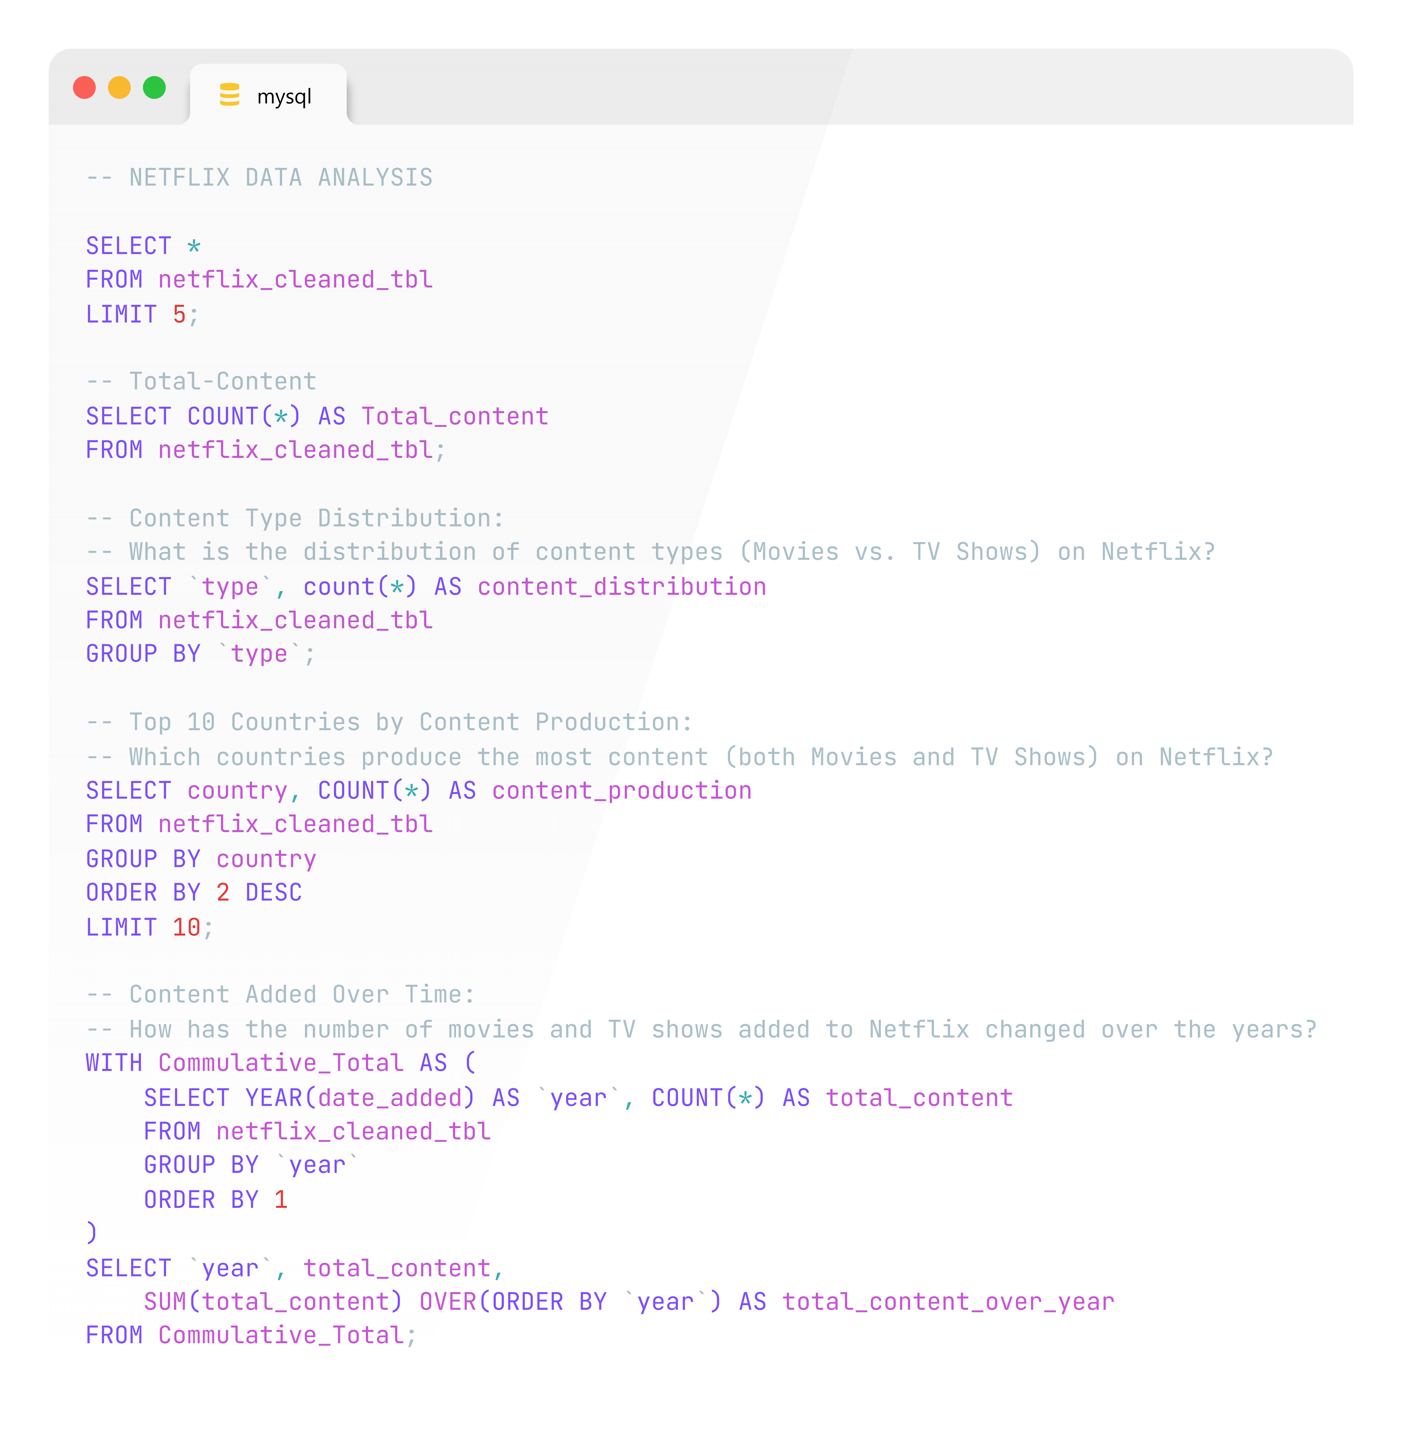
MYSQL
QUERIES

Slide 7
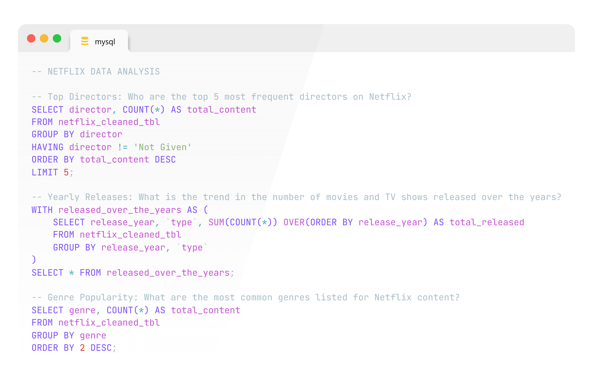
MYSQL
QUERIES

Slide 8
MYSQL
QUERIES

Slide 9

MYSQL
QUERIES

Slide 10
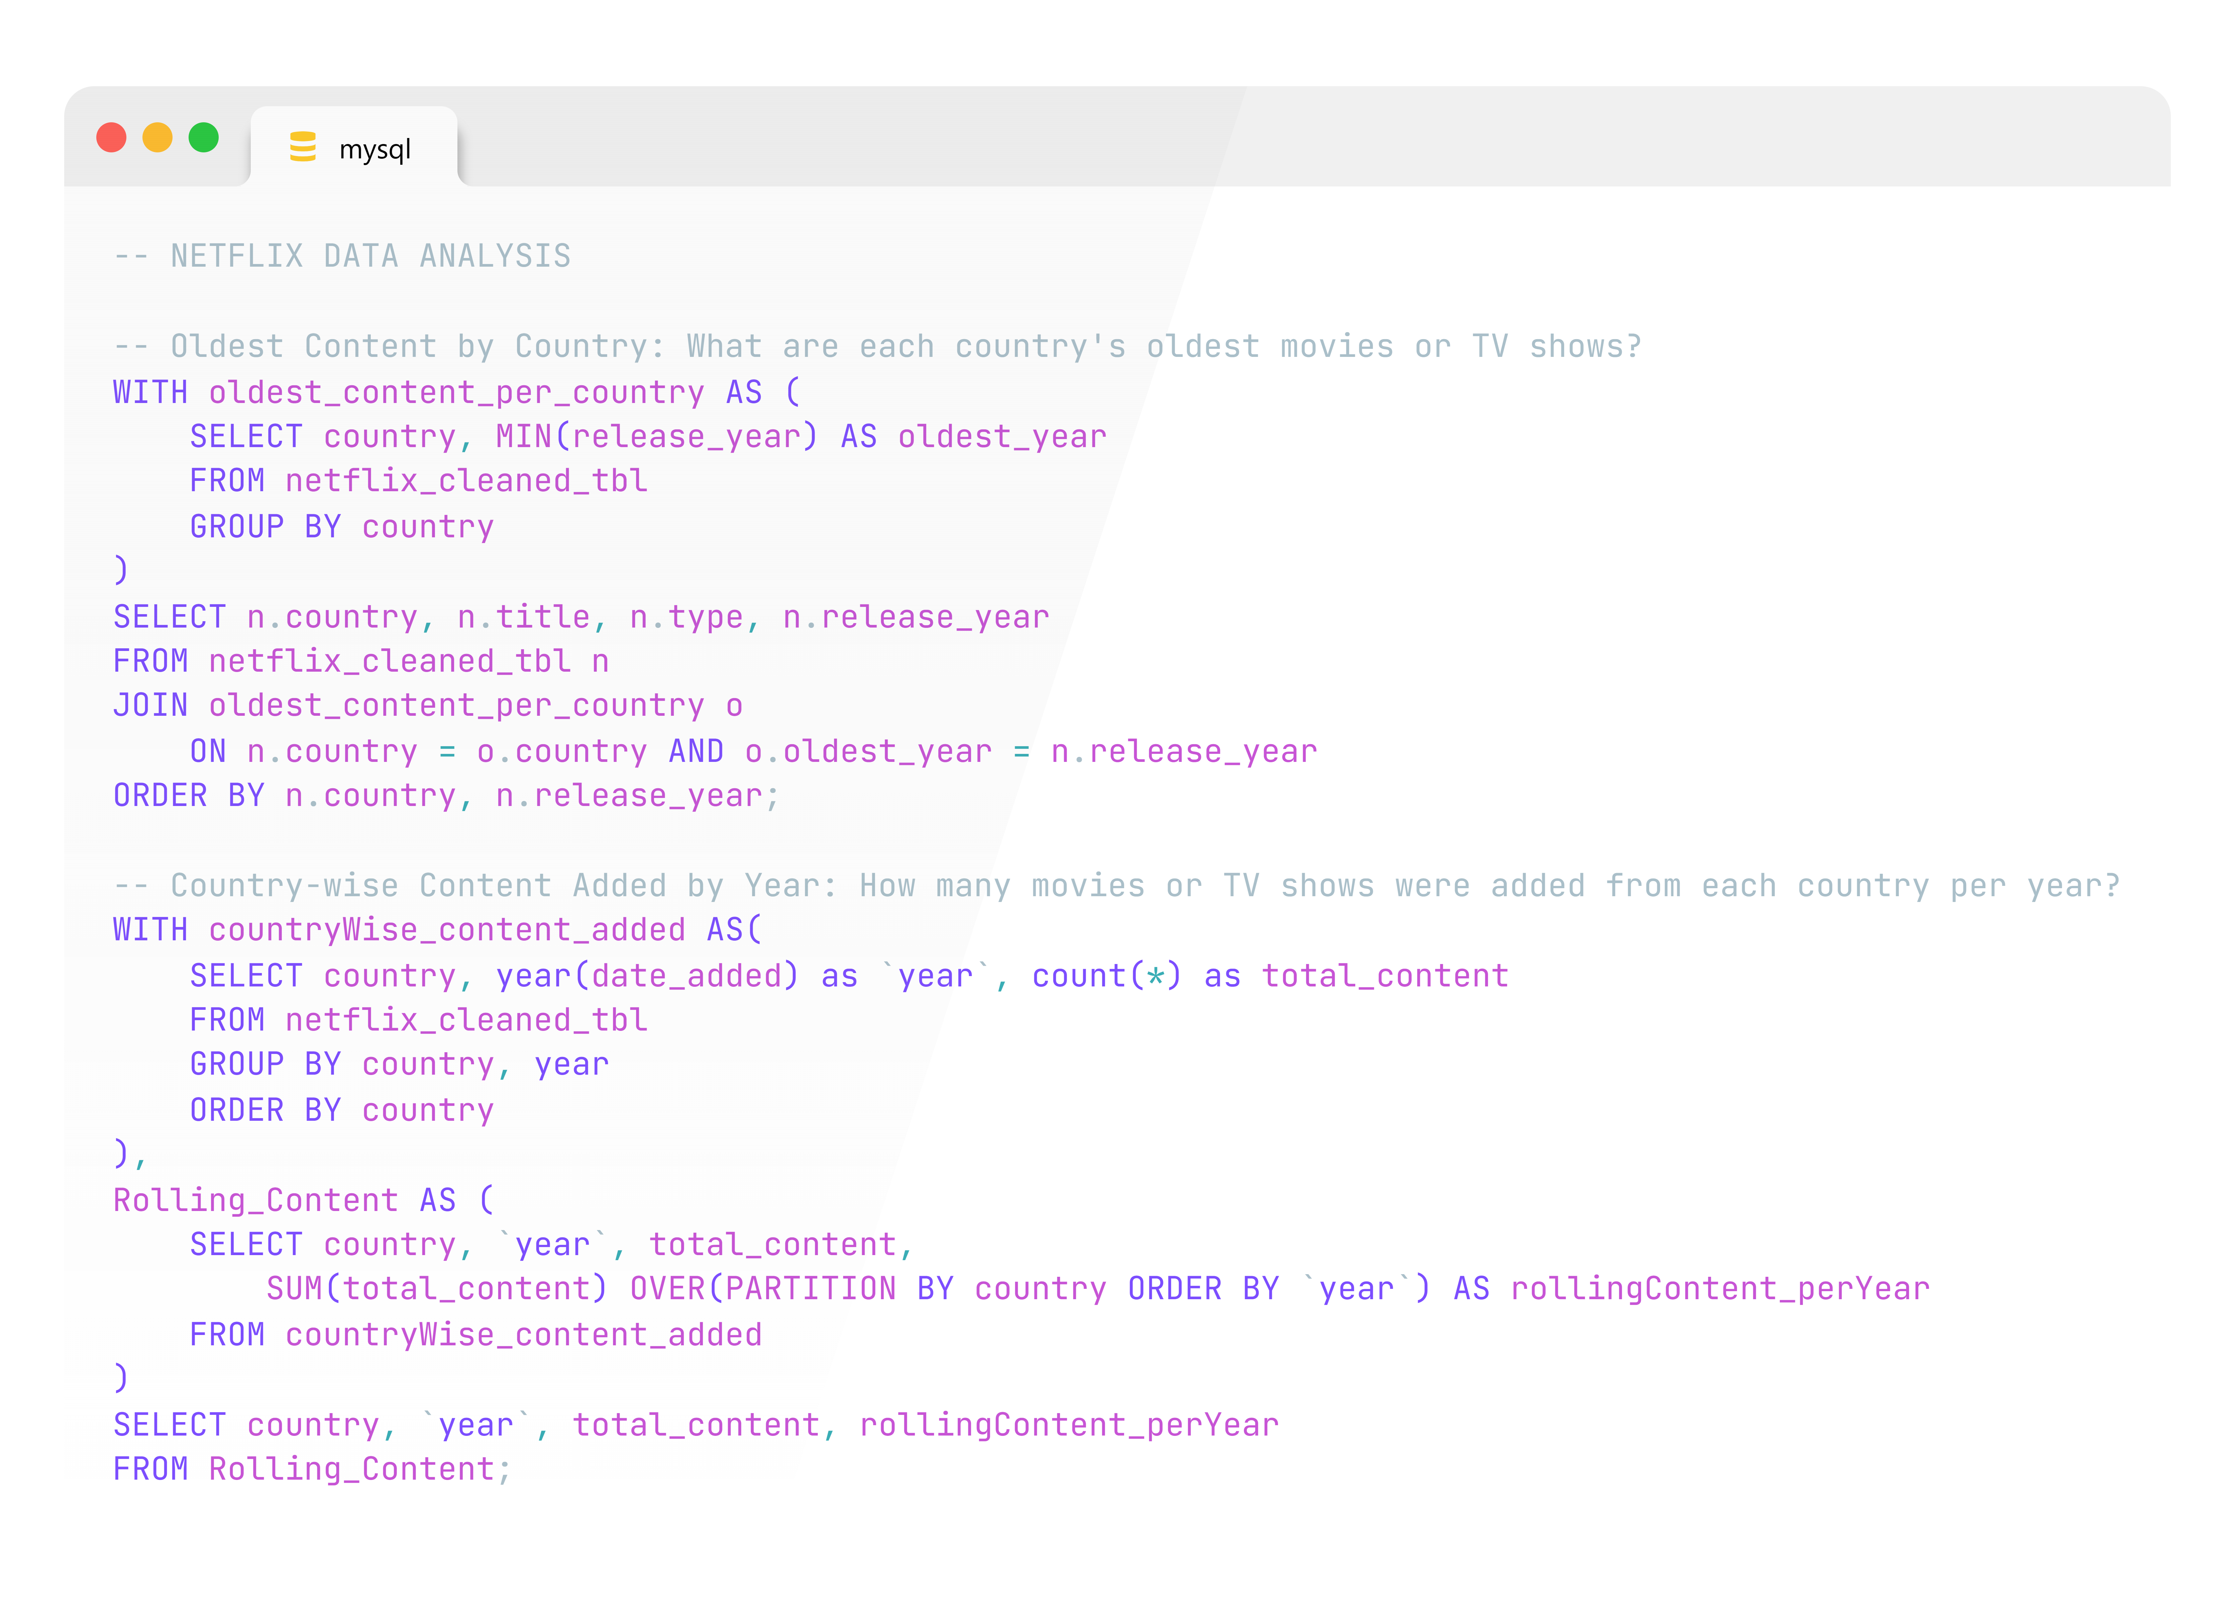
MYSQL
QUERIES

Slide 11
Content Added Over Time
The number of new movies and TV shows added to Netflix has varied significantly over the years, with an upward trend that highlights Netflix's expansion. The cumulative count of content by year provides a clearer view of this growth over time.
Top Directors
The top 5 directors with the most content on Netflix are some of the most prolific creators, possibly indicating high viewer demand for their work. This insight could help Netflix prioritize collaborations with these directors or similar content producers.
Yearly Releases
Tracking the number of releases by year and type shows Netflix’s focus on different content types over time. This trend helps illustrate whether Netflix has increased production in movies or TV shows in recent years.
Genre Popularity
The most common genres reflect popular viewing preferences, helping Netflix understand which genres resonate most with audiences. High-popularity genres could be further expanded, while niche genres offer opportunities to diversify the library.
Content per Country (Genre-Specific)
Each genre’s top-producing country shows regional strengths in content creation, such as specific genres being highly popular in particular regions. Netflix can leverage this insight for geo-targeted content strategies or regional production partnerships.
Rating Distribution
The rating distribution highlights the age demographics Netflix is targeting most. Ratings with higher counts suggest a focus on certain audience groups, such as adults (e.g., TV-MA) or families (e.g., PG-13).
INSIGHTS

Slide 12
Average Duration by Type
Movies and TV Shows on Netflix have different average durations, with movies averaging a certain length in minutes and TV Shows averaging several seasons. This analysis aids in content planning and setting audience expectations around content length.
Most Active Year for New Content
The year with the highest number of additions reflects Netflix’s peak investment in content expansion, helping stakeholders assess which years saw the most aggressive growth in content offerings.
Top 5 Genres by Country
The top 5 genres in each country provide a region-specific view of content preference. This information is valuable for Netflix’s marketing and content localization strategies, allowing them to align offerings with local tastes.
Most Common Directors by Genre
Directors frequently associated with specific genres may be considered genre specialists, often producing content within genres like action, drama, or comedy. Netflix can use this insight to attract directors skilled in the genres with high viewer interest.
Oldest Content by Country
The oldest content from each country shows the platform's historical depth by region, illustrating how far back Netflix’s library reaches in terms of international content offerings.
Country-wise Content Added by Year
This analysis shows content addition patterns by country and year, with a rolling total for each year. This can highlight consistent content-producing countries as well as emerging contributors over time.
INSIGHTS

Slide 13
RECOMMENDATIONS
1. Expand Popular Genres in Key Markets
Recommendation: Increase the availability of high-demand genres (e.g., Drama, Comedy) in countries where they are most popular. This localized approach can drive subscriber growth by catering to regional preferences.
2. Leverage High-Performing Directors and Genre Specialists
Recommendation: Collaborate with top-performing directors who specialize in popular genres to attract genre-loyal viewers. This could include exclusive content deals with these directors or similar creators to expand the platform’s genre appeal.
3. Diversify Rating Categories to Reach Wider Demographics
Recommendation: Based on the distribution of ratings, consider adding more content for underserved demographics. For instance, if TV-MA content dominates, producing more family-friendly or youth-oriented content (e.g., PG-13 or TV-Y) could attract broader audience segments.
4. Optimize Content Length to Match Viewing Preferences
Recommendation: For TV Shows, consider producing more series with shorter seasons if long series are less popular, or longer seasons if the opposite is true. In Movies, experiment with length variations to match viewing habits, especially if certain average durations show higher engagement.
5. Regionalize Content Production for Growth in Emerging Markets
Recommendation: Expand production partnerships in countries with growing content production numbers, especially where Netflix has been actively adding content. This can strengthen local market presence, especially in regions with emerging subscriber bases.

Slide 14
RECOMMENDATIONS
6. Maintain High Content Release Rates During Peak Years
Recommendation: Maintain or replicate the strategy used in Netflix’s most active content release years. This can involve aligning marketing campaigns, regional partnerships, and content types that drove growth, especially to retain existing subscribers and attract new ones.
7. Focus on Oldest Content’s Value as a Nostalgia Factor
Recommendation: Leverage the oldest content available on Netflix as a nostalgic or classic offering. This could be bundled or highlighted for viewers interested in timeless films or series, potentially engaging older demographics or new audiences seeking classics.
8. Refine Geo-Targeted Genre Strategies
Recommendation: For each country’s top genres, create specialized marketing campaigns and suggest similar content to users interested in that genre. This could help increase engagement and reduce churn by creating a highly personalized viewing experience.

